Slide 1
CSE299 WEEK 10
Prepared by
Md. Abdullah Al Jobaer
1512028042

Slide 2
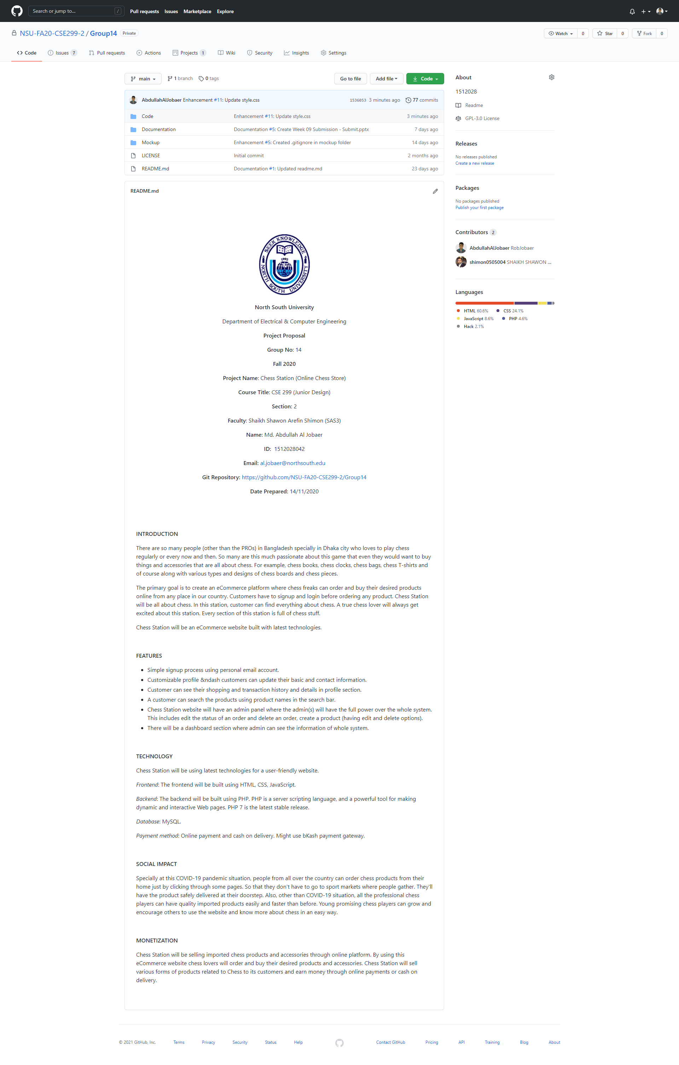
GitHub FRONT PAGE with PROJECT README

Slide 3
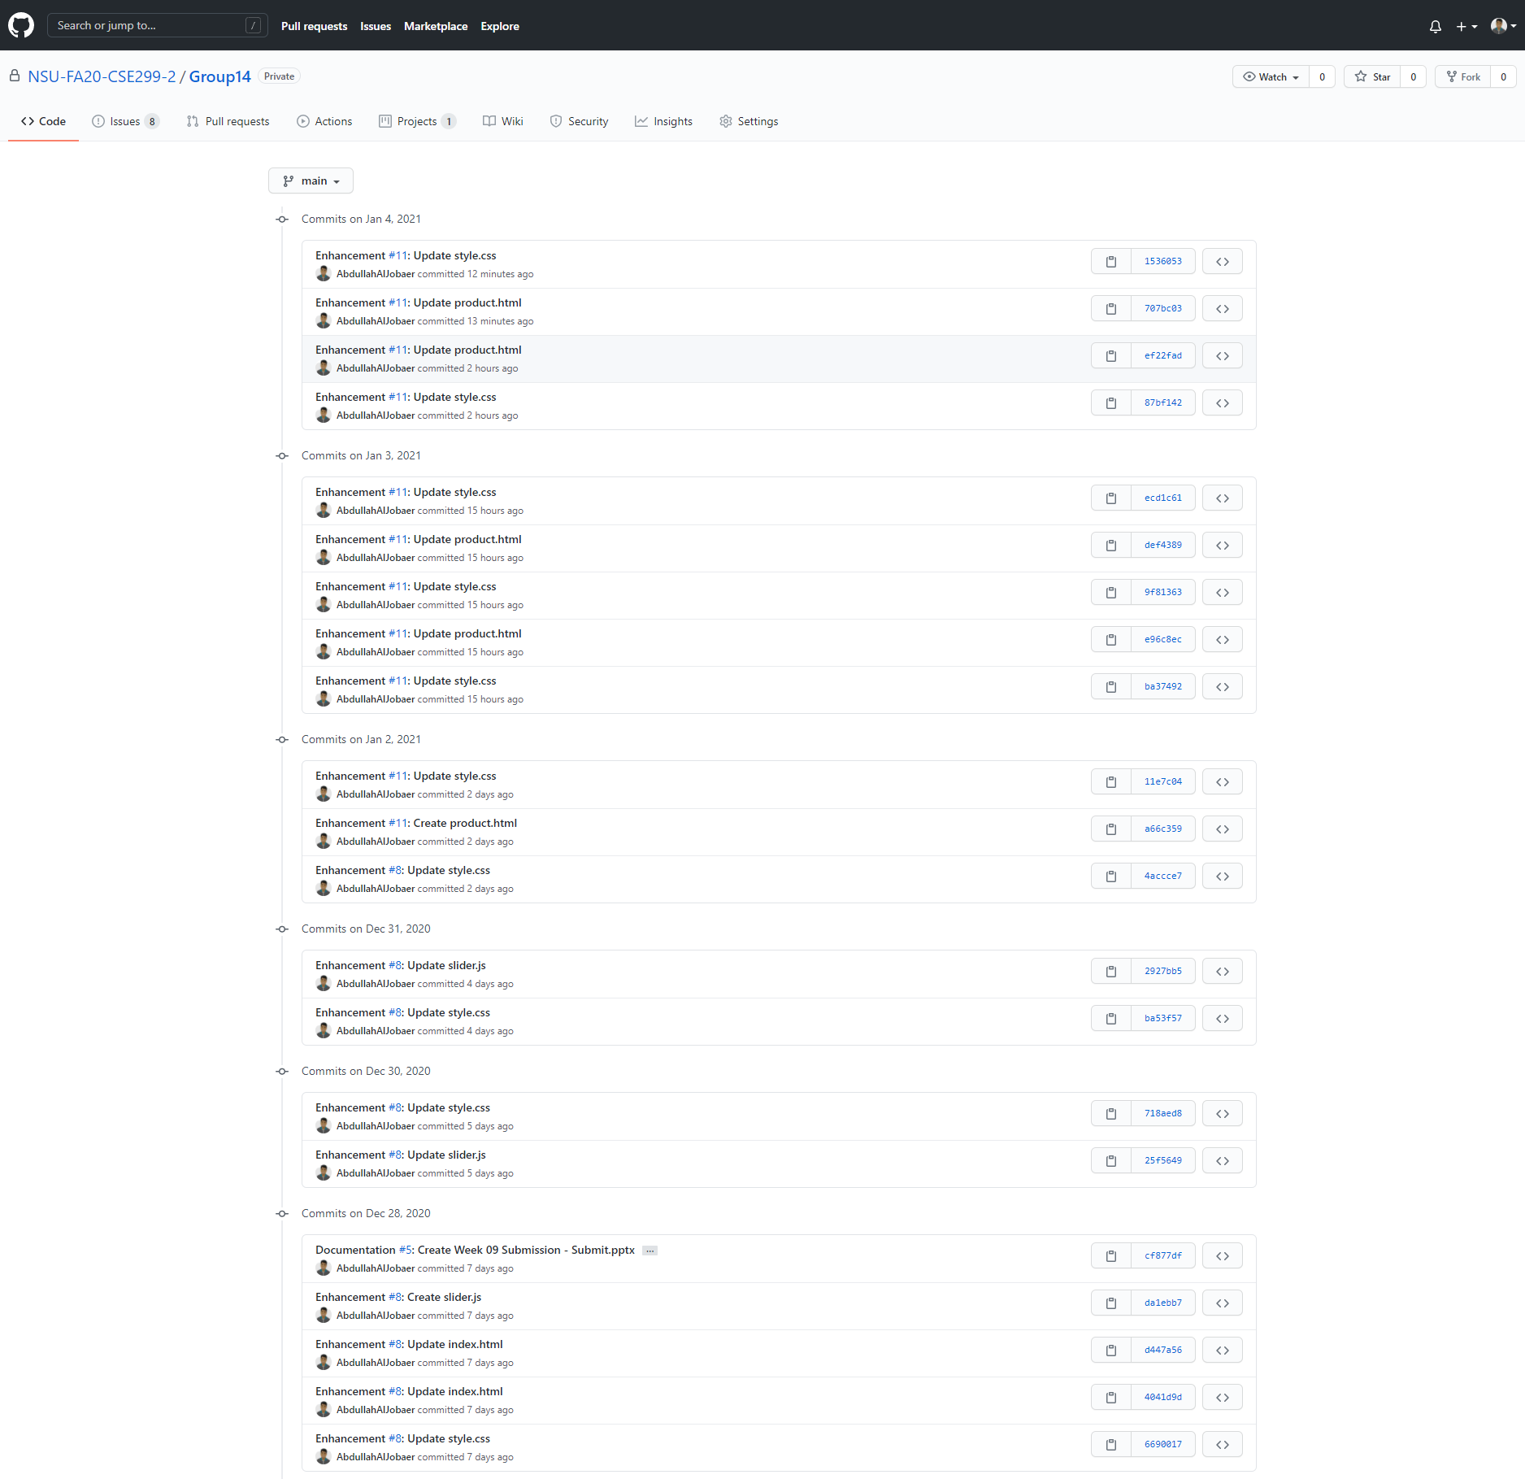
COMMITS

Slide 4
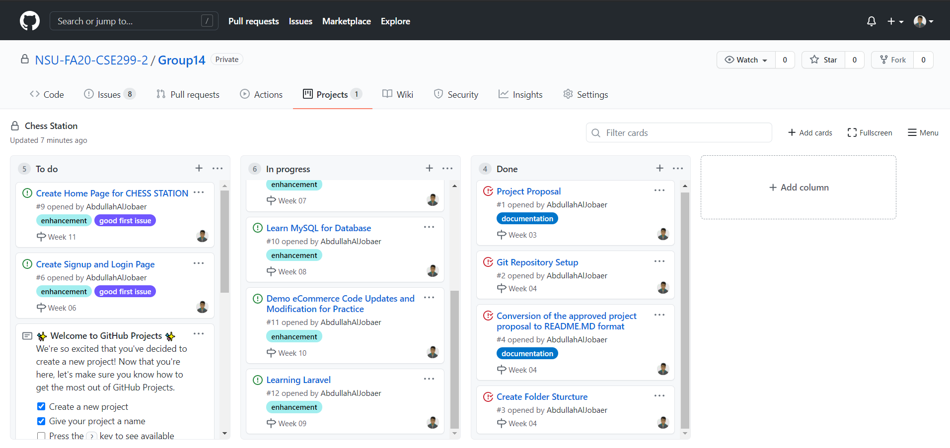
GitHub ISSUE BOARD

